Slide 1
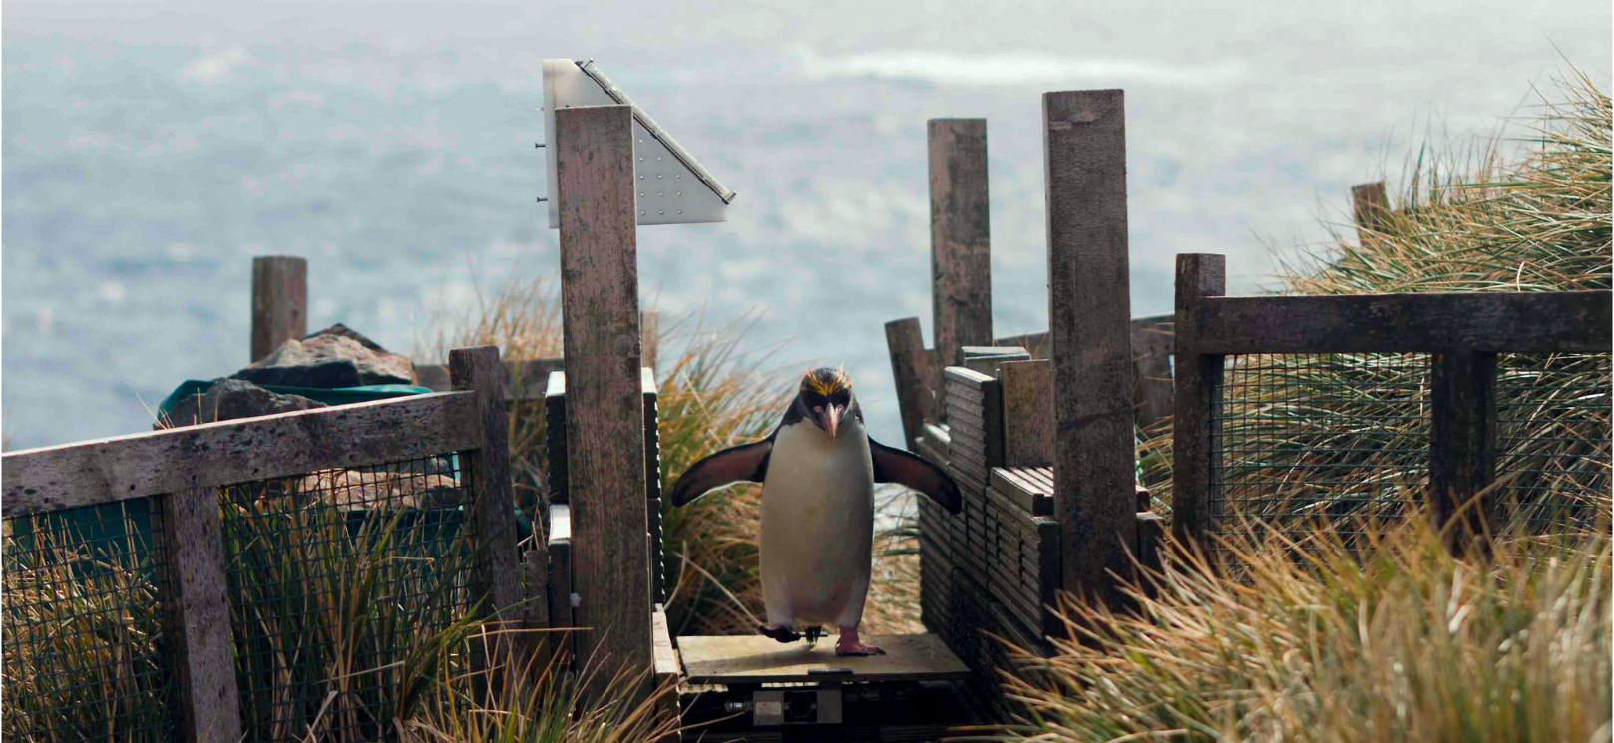
Determining penguin phenology
from a very large force sensor data set
Philipp Boersch-Supan British Trust for Ornithology @pboesu
Helen Peat & Phil Trathan British Antarctic Survey

Slide 2
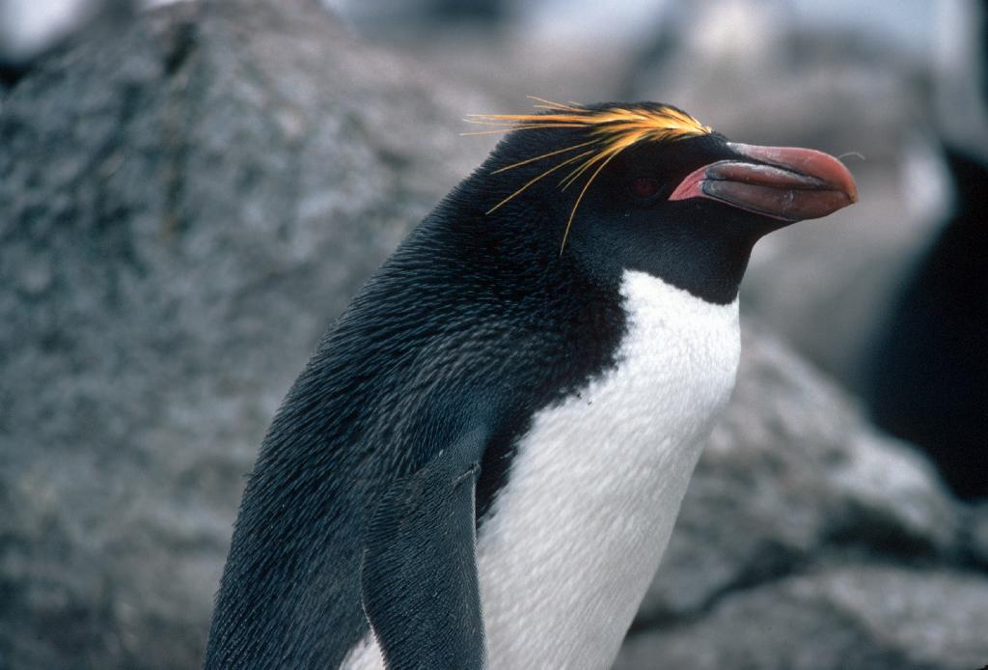

Study system: Macaroni penguin Eudyptes chrysolophus
6 million breeding pairs globally
single largest seabird consumer of prey biomass (krill, lanternfish)
populations strongly declining
Image: BAS
Original motivation for data collection:
Study body condition, foraging success, provisioning rates to better understand demographic rates
@pboesu

Slide 3
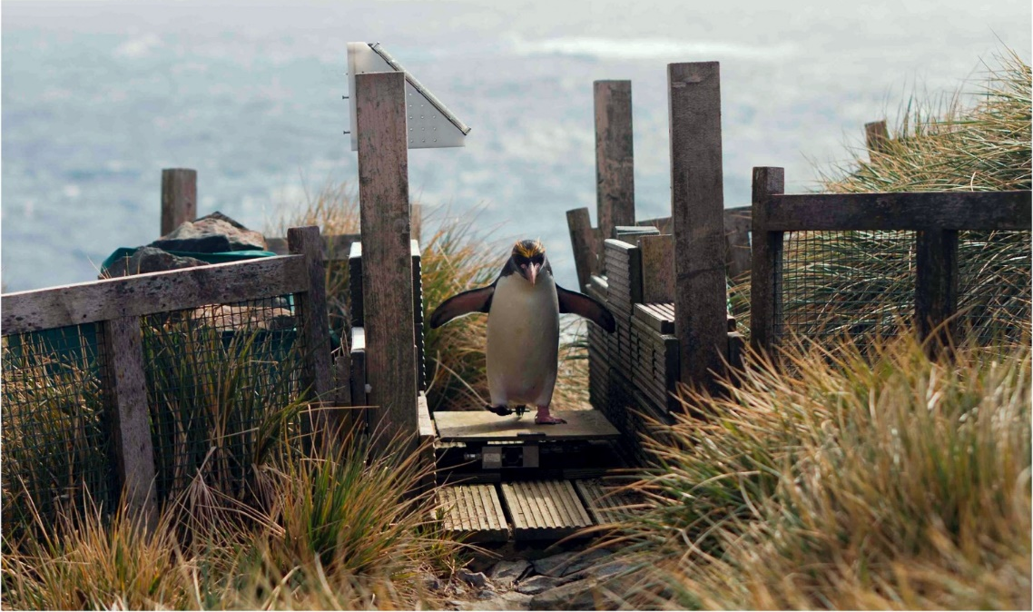
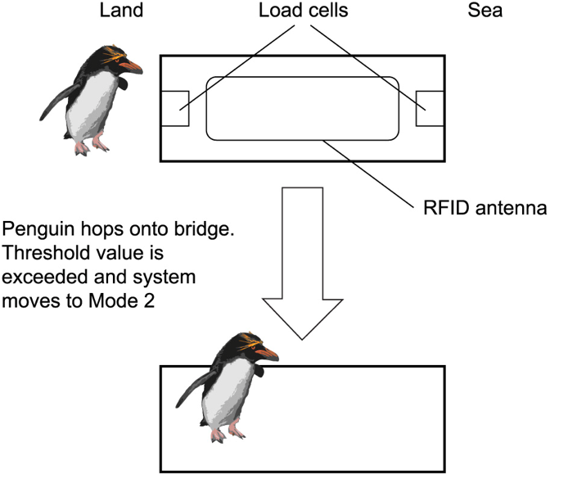
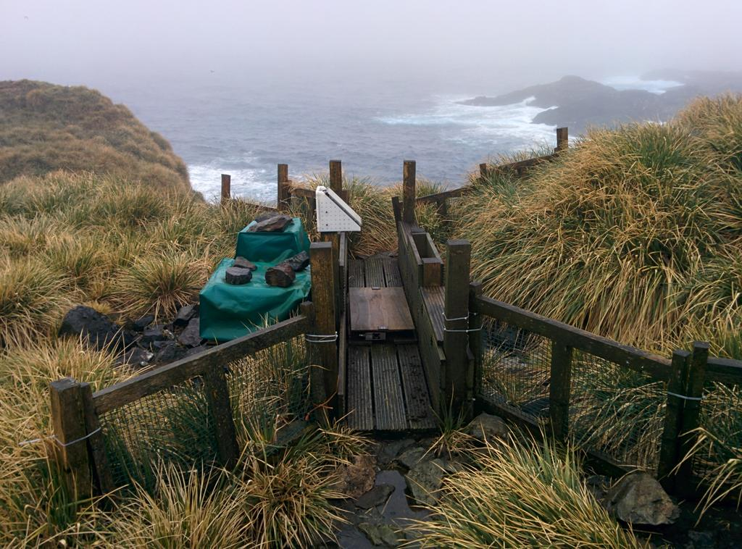
The penguin weighbridge of the British Antarctic Survey
@pboesu

Slide 4
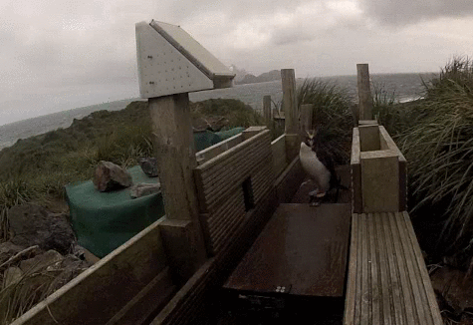
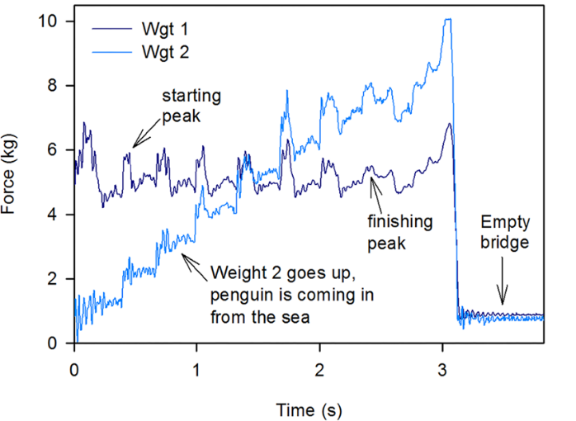
Measurement principle
(1) RFID read identifies individual
(2) Integrate force over time to get penguin mass
(3) Difference between outbound and inbound mass = meal mass
accurate mass requires high-frequency sampling:
50,000-80,000 crossings/season = 40 – 60 million raw data points/season
Big data challenge at processing stage
@pboesu
Afanasyev et al. 2015 PLoS ONE

Slide 5
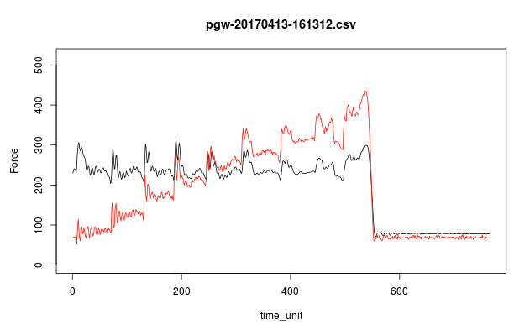
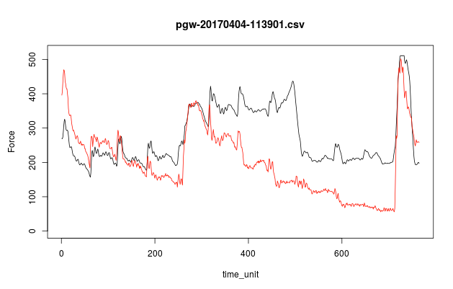
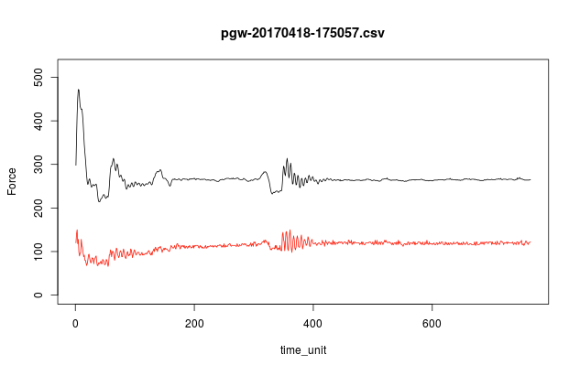
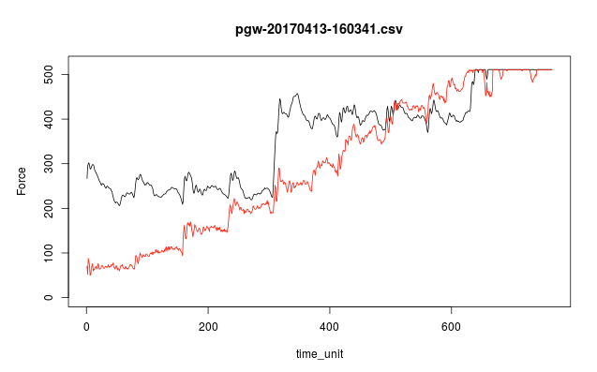
and, penguins don’t play by the rules…
design case: 1 walking bird
too busy: 3 birds in succession
not busy enough: 1 standing bird
way too busy: 3 birds in succession
Multiple crossings account for c. 30% of crossing birds
Doesn’t interfere with tag detection per se, but limits detection of directionality,
calculation of weights, assignment of weights to individuals
@pboesu

Slide 6
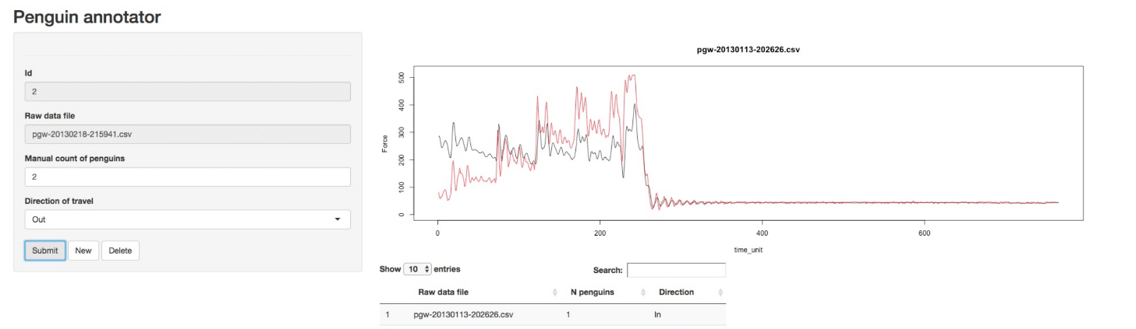
Step 1: The penguin annotator (shiny + RPostgres)
Easy manual classification and enumeration of penguins
but 50k+ files/yr prohibitively time intensive
Simple decision trees failed (drastic changes in body mass during season)
Need a classifier that has ‘time-series shape recognition’
@pboesu

Slide 7
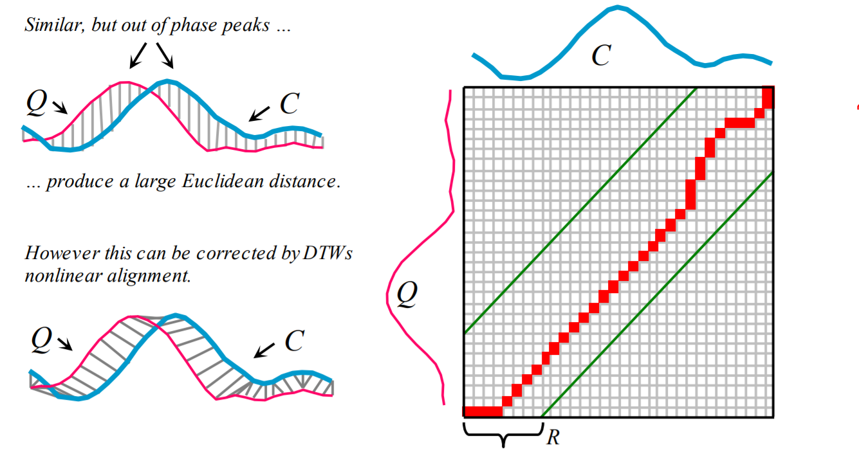
Step 2: Dynamic Time Warping
Rakthanmanon et al. 2012, Proc SIGKDD
very good accuracy >90%
too costly (~ 1 min) to compute & compare full warping path for each crossing
@pboesu

Slide 8
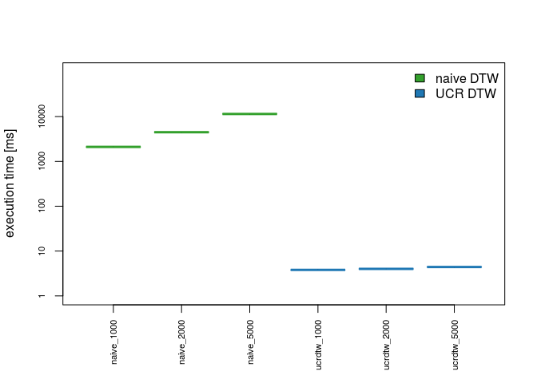
Ultrafast Dynamic Time Warping to the rescue!
‘best match’ search, exploits early abandoning on multiple levels
2-3 orders of magnitude faster than naïve DTW comparisons
Open C++ source available from Rakthanmanon et al. 2012
R bindings now implemented in install.packages("rucrdtw")
Could be of interest to accelerometer/acoustic data?!
A single season of penguin crossings can now be classified in <1hr
i.e. counts, directions for statistical modelling
@pboesu
Rakthanmanon et al. 2012, Proc SIGKDD
Boersch-Supan 2016, J Open Source Software

Slide 9
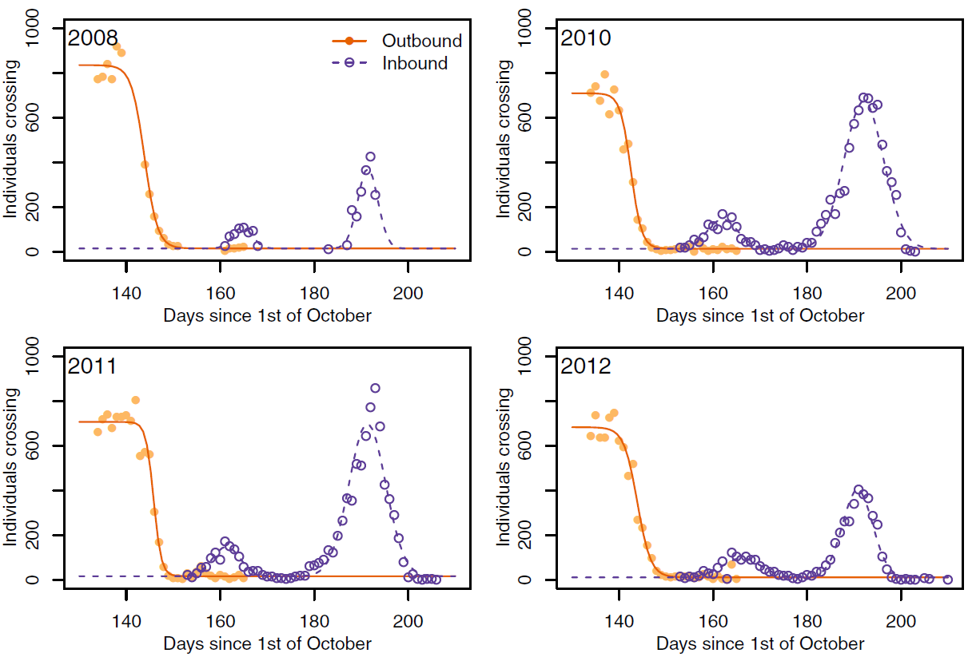
Quantifying event timing from daily counts
Inference approach:
Gaussian mixture model expressed as hierarchical non-linear regression
Bayesian estimation w/ informative priors
Phenological curves allow for missing data, overlap of events
Linden et al. 2017, J Avian Biol
Boersch-Supan et al. in prep

Slide 10
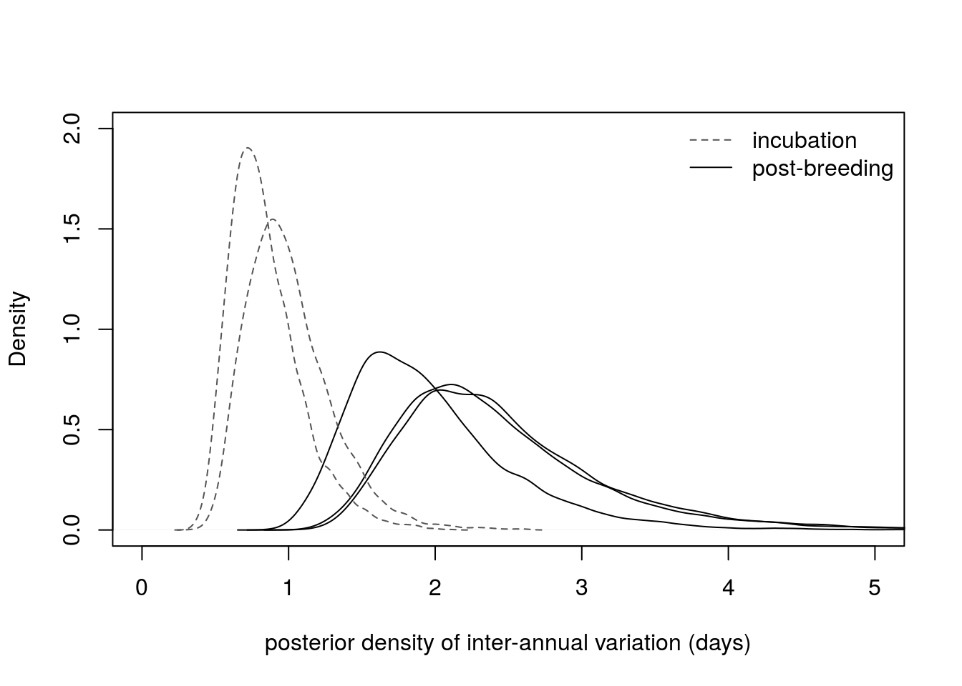
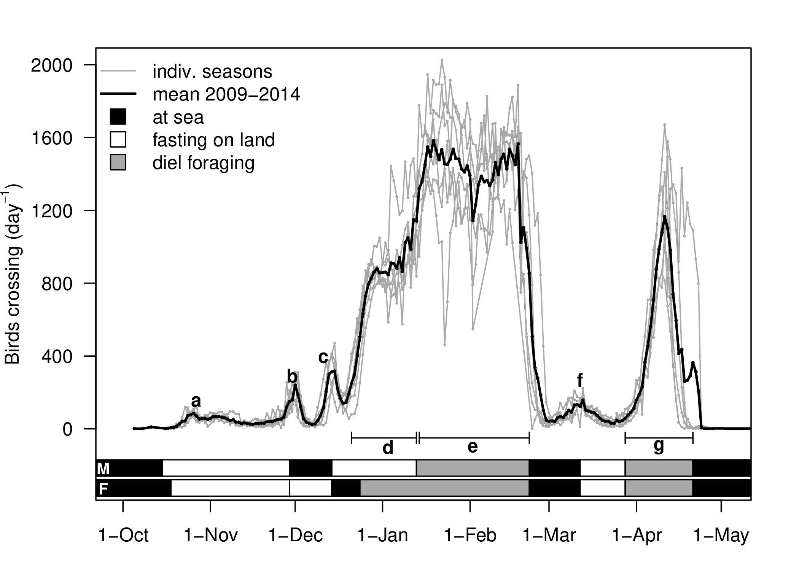
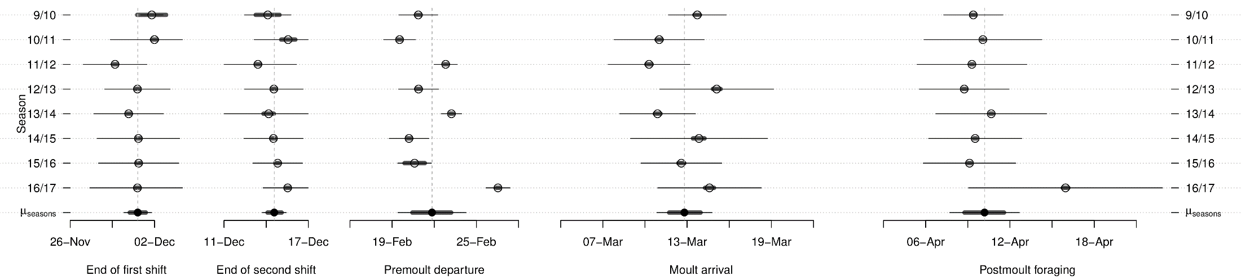
Inter-annual variation in breeding/moult timing
Timing of breeding events less variable among years than timing of moult/post-moult events
Boersch-Supan et al. in prep

Slide 11
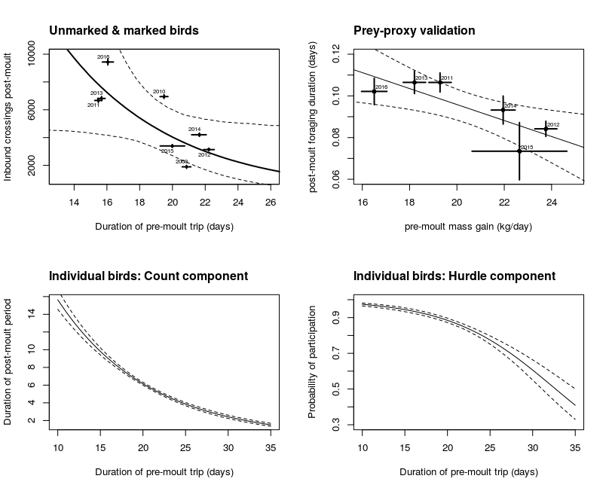
Linking post-moult movement to prey abundance
Inference approach:
errors-in-variables GLMs
Bayesian estimation
LOO-IC model selection
Neg. binomial hurdle model
Subject-level random effect
Bayesian estimation
LOO-IC model selection
When pre-moult feeding is good, more birds delay migration for longer
Krill abundance during brood-guard was not an informative predictor of post-moult activity
Central place foraging may have energetic (thermoregulation) and/or social benefits

Slide 12


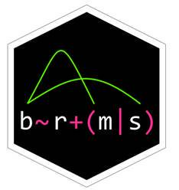

Workflow overview
Raw data (read-only psql tables)
“big data” but “small regression”
N = 6-8 years!
RPostgres
Statistical models
Classified crossings
Reference dataset
rucrdtw
Penguin Annotator
@pboesu

Slide 13
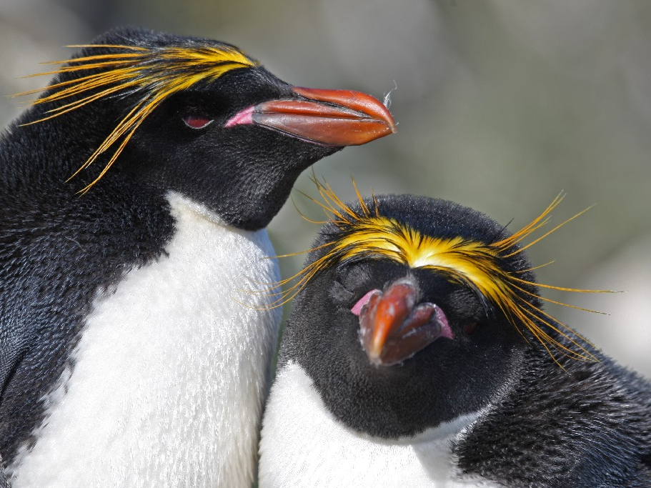
Thank you for listening!
http://pboesu.github.io
pboesu@gmail.com
@pboesu
Thank you to
BAS engineers, data team & field technicians
rucrdtw reviewers & users: Maëlle Salmon, Noam Ross, Florian Pfisterer
BAS

Slide 14
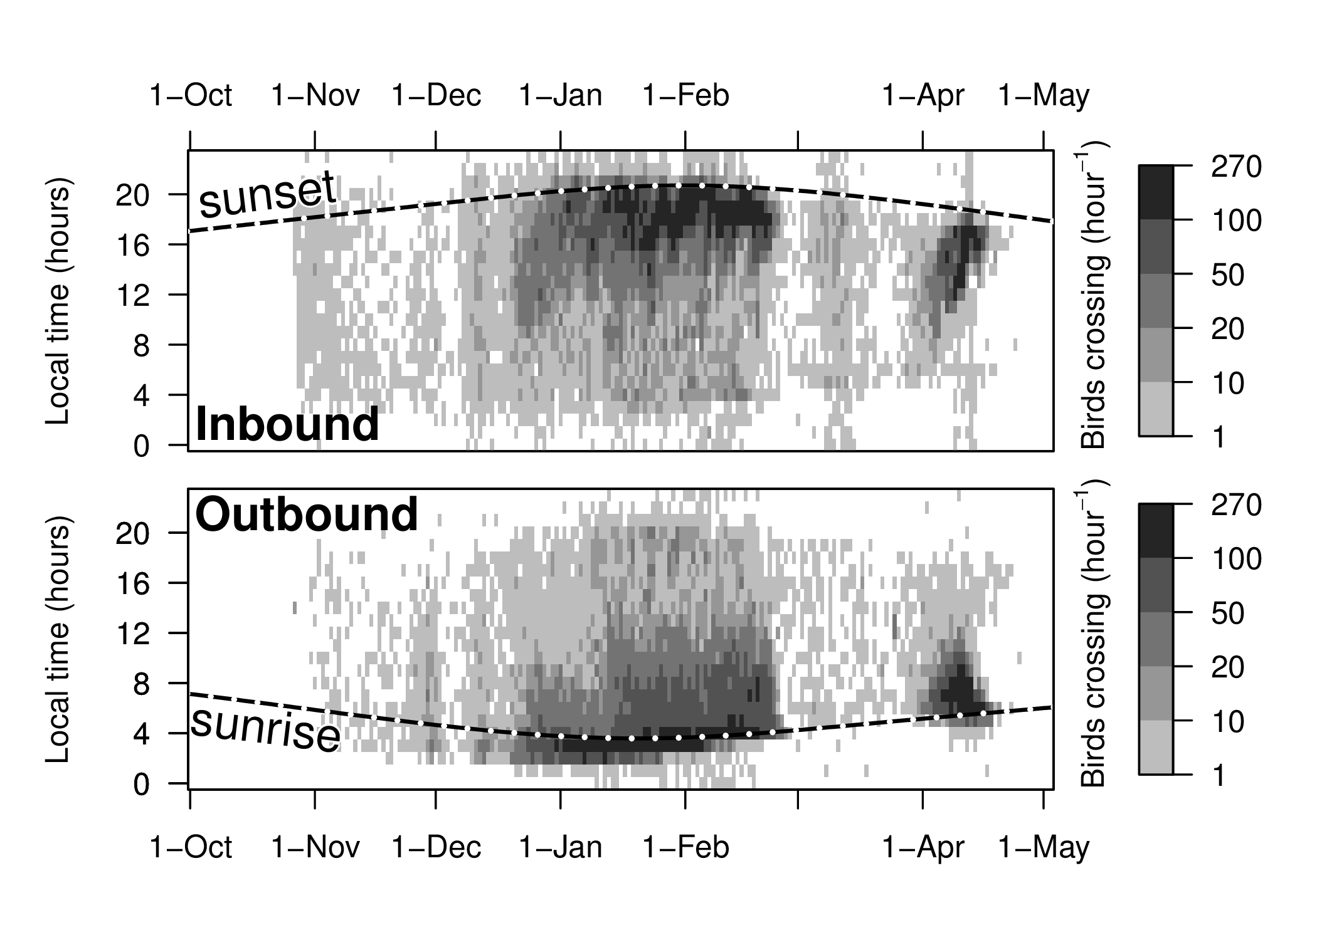
One of several results: rush hour!
Boersch-Supan et al. in prep

Slide 15
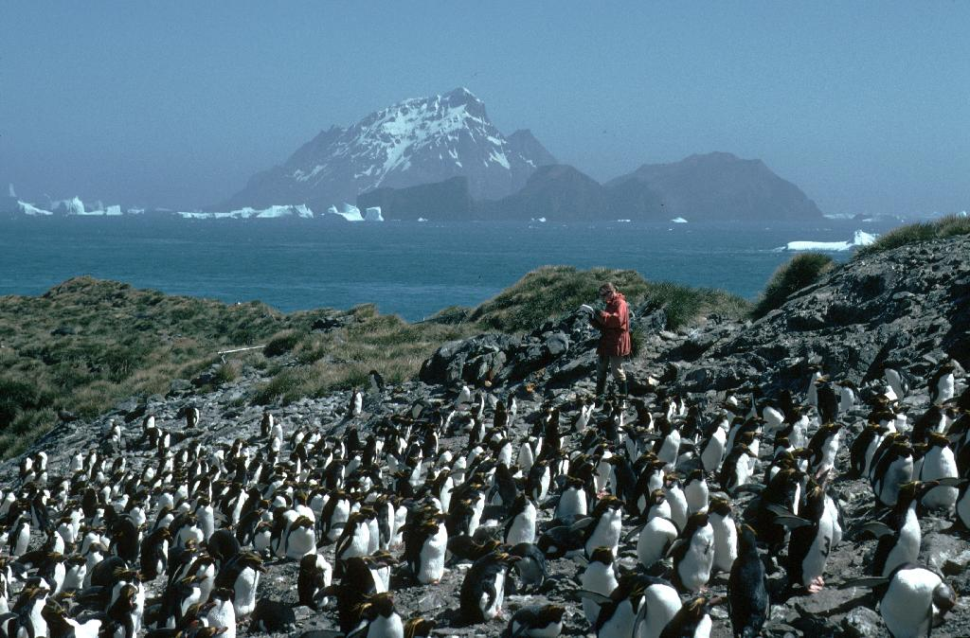
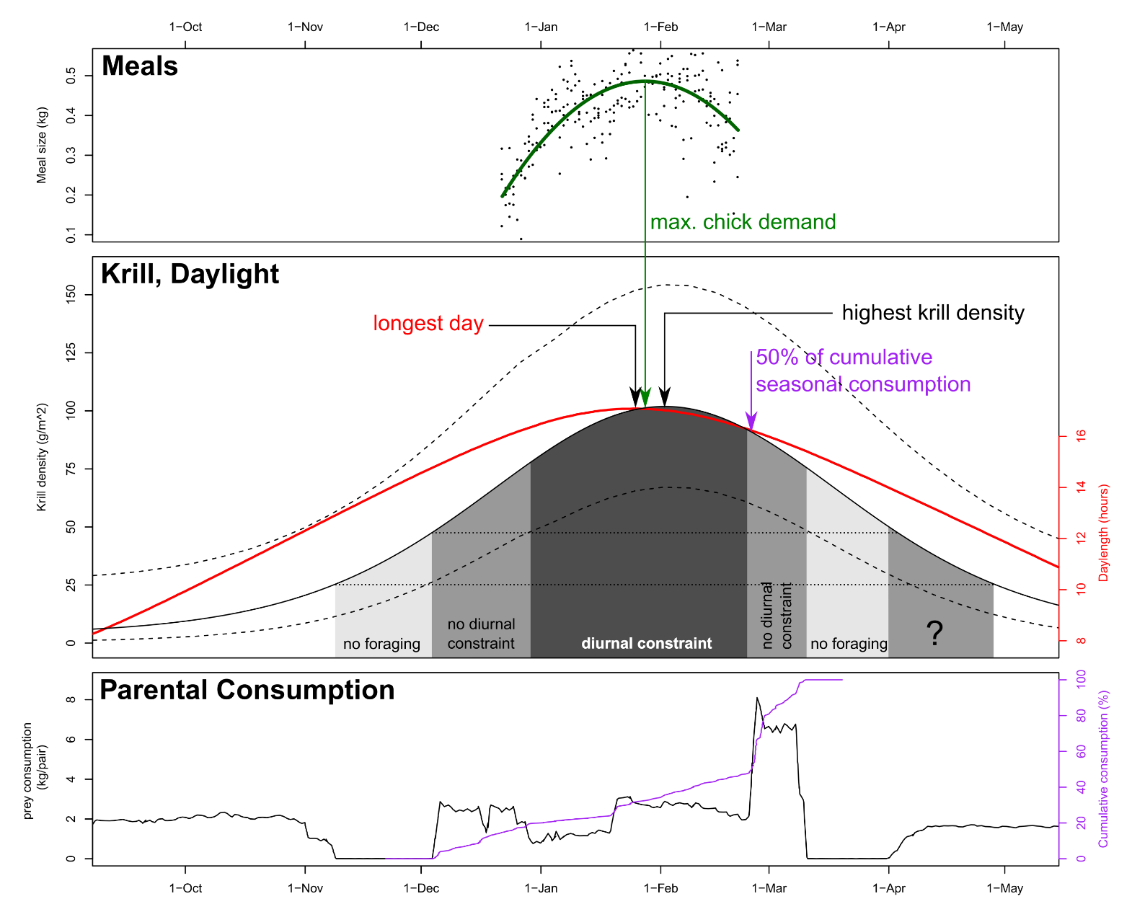
Penguins modulate post-breeding phenology, but not breeding phenology in response to local prey availability.
Bad news for breeding success if summer krill peak shifts permanently?
BAS

Slide 16
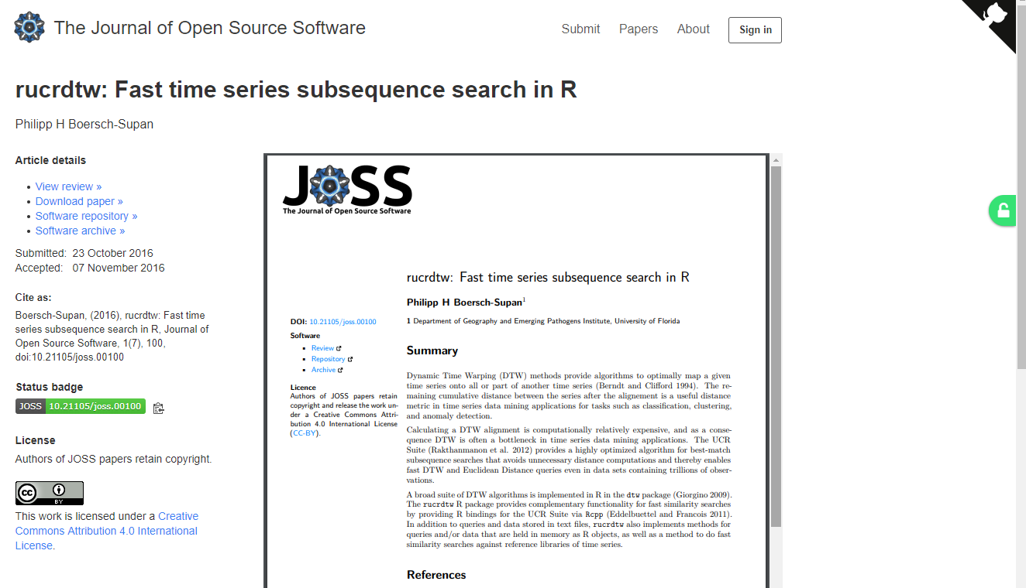

Software paper in JOSS @JOSS_TheOJ
Great experience: Fast, constructive, friendly, transparent
Would recommend!
@pboesu

